Slide 1
Applications of Acoustic Metamaterials: Noise Reduction
Presented By: Ryan Hill & Ed Stokes
University of North Carolina at Charlotte
Ed Stokes, ECE Professor
Ryan Hill, ECE Graduate Student
Matias Mendieta, ECE Undergraduate Student
Patrick Bruce, ECE Undergraduate Student

Slide 2
Outline
Co-funding and Center I.P.
Case study: Characterization of fan noise
Experimental Setup
Modeling (Comsol Multi-Physics)
Measurements on Large Helmholtz Resonators
Design and fabrication of coupled H.R. arrays
Initial test results
Future: Acquisition of 4 mic impedance tube

Slide 3
Co-funding & Center I.P.
Project in 2017-18 was funded by Center for Metamaterials
Arrays of miniature coupled Helmholtz resonators is probably a patentable concept
Especially if coupled with specific applications.
We are moving toward functional prototypes.
Appropriate patent application(s) will be filed as results are demonstrated.

Slide 4
Need and Relevance: Objectives
Develop Acoustic Metamaterial structures to absorb noise e.g. cooling fans in electronic systems.
Would like to use Helmholtz resonators with small geometry to filter fan noise (~800Hz) frequencies
However, H.R. size is larger for lower frequencies
Therefore, size optimization is critical for miniature arrays
Eventually, the design methodology will be applied to other applications.

Slide 5
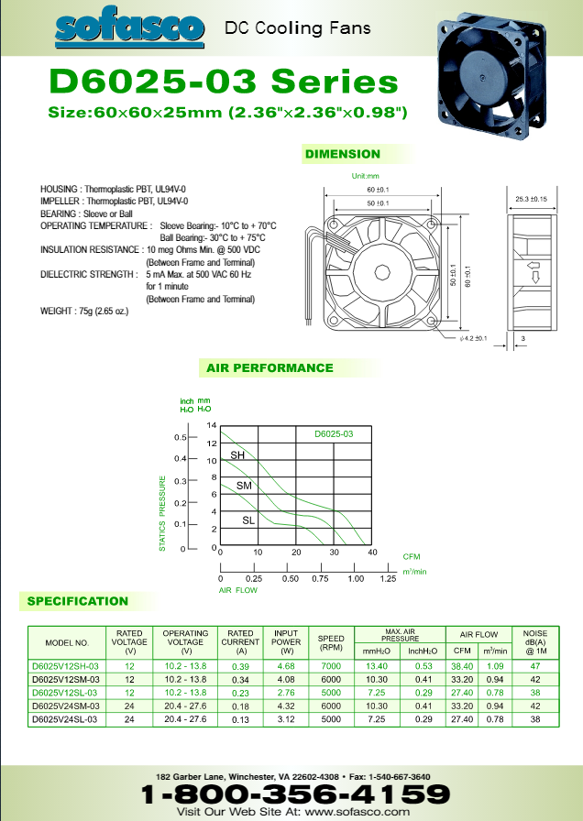
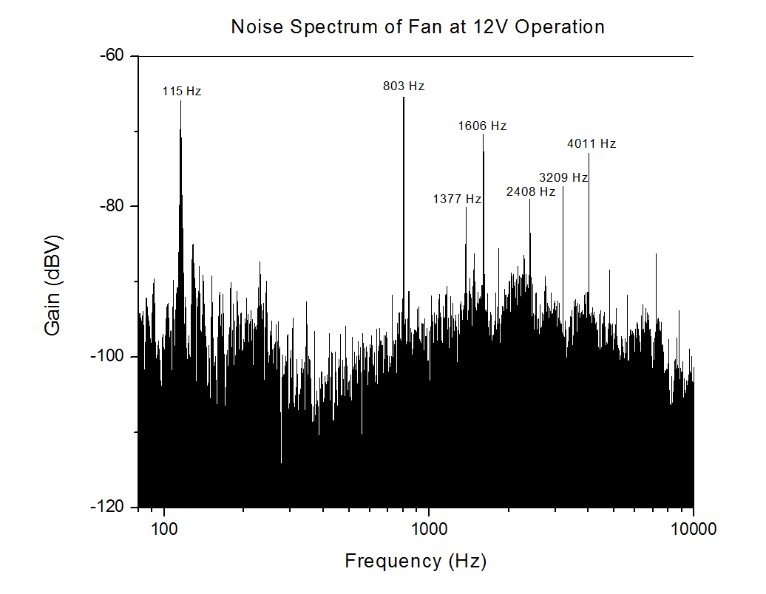
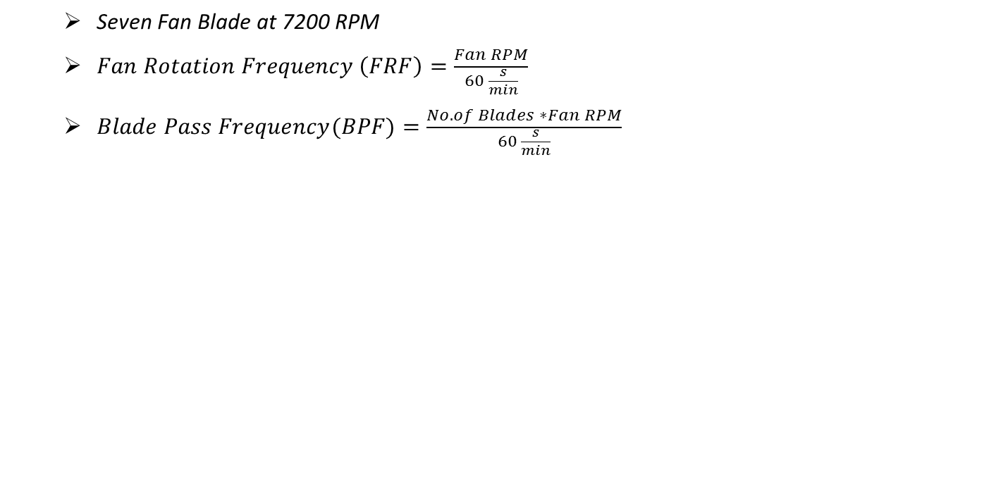
Typical Cooling Fan Data
Seven Fan Blade at 7200 RPM
$Fan Rotation Frequency \left(FRF\right)=\frac{Fan RPM}{60 \frac{s}{min}}$
$Blade Pass Frequency(BPF)=\frac{No. of Blades ∗Fan RPM}{60 \frac{s}{min}}$
Peak # | What is it? | Calculated | Measured
1 | FRF Harm. #1 | 117 Hz | 115 Hz
2 | BPF Harm. #1 | 817 Hz | 803 Hz
3 | ??? | N/a | 1377 Hz
4 | BPF Harm. #2 | 1634 Hz | 1606 Hz
5 | BPF Harm. #3 | 2451 Hz | 2408 Hz
6 | BPF Harm. #4 | 3268 Hz | 3209 Hz
7 | BPF Harm. #5 | 4085 Hz | 4011 Hz

Slide 6
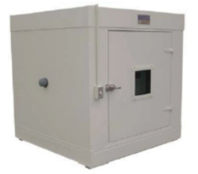
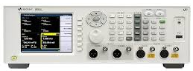
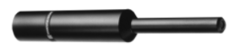
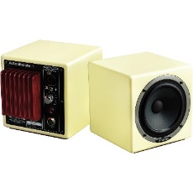
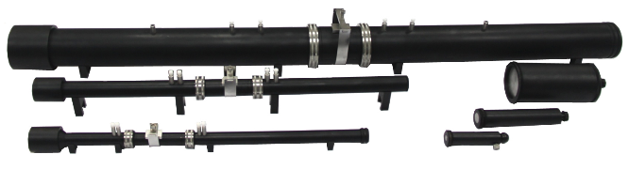
Notable Capabilities of the Lab
“Quiet Box” – ETX Lindgren SD Acoustic Chamber
Dimensions: 28 X 26 X 28 inches
Testing Frequency: > 500 Hz
U8903B Agilent Audio Analyzer
2 Generators, 2 Analyzers
10 kHz – 80 kHz (+/- 0.0005 %)
(3) Measurement Microphones
Frequency Response: 20 Hz – 20 kHz
Omnidirectional Polar Pickup Pattern
Flat Response
(2) Avantone Mixcube Active Full-Range Reference Monitor
Frequency Response: 50 Hz – 17 kHz
(Future) BSWA Impedance Tube System
Measured Frequency Range: 63 Hz – 6.1 kHz

Slide 7
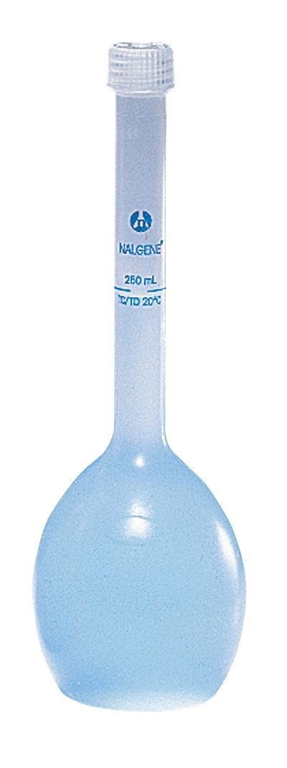
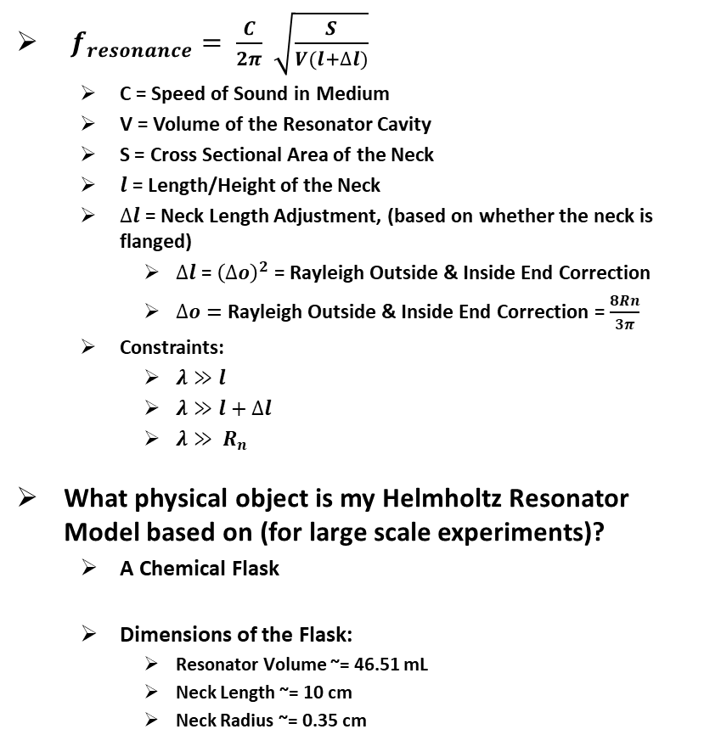
Helmholtz Resonator Equation and Design
Approach:
Assume the HR neck remains a constant value and only vary the geometry that controls the HR cavity volume
For large scale experiments, add or remove water from the flask to change the cavity volume
Take the constraints into account when designing the Acoustic Metamaterial.
$f_{resonance}= \frac{C}{2π} \sqrt{\frac{S}{V(l+∆l)}}$
C = Speed of Sound in Medium
V = Volume of the Resonator Cavity
S = Cross Sectional Area of the Neck
$l$ = Length/Height of the Neck
$∆l$ = Neck Length Adjustment, (based on whether the neck is flanged)
$∆l$ = ${\left(∆o\right)}^{2}$ = Rayleigh Outside & Inside End Correction
$∆o=$ Rayleigh Outside & Inside End Correction = $\frac{8Rn}{3π}$
Constraints:
$λ≫l$
$λ≫l+∆l$
$λ≫ R_{n}$
What physical object is my Helmholtz Resonator Model based on (for large scale experiments)?
A Chemical Flask
Dimensions of the Flask:
Resonator Volume ~= 46.51 mL
Neck Length ~= 10 cm
Neck Radius ~= 0.35 cm

Slide 8
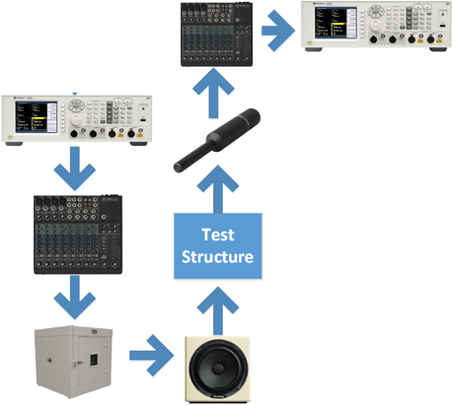
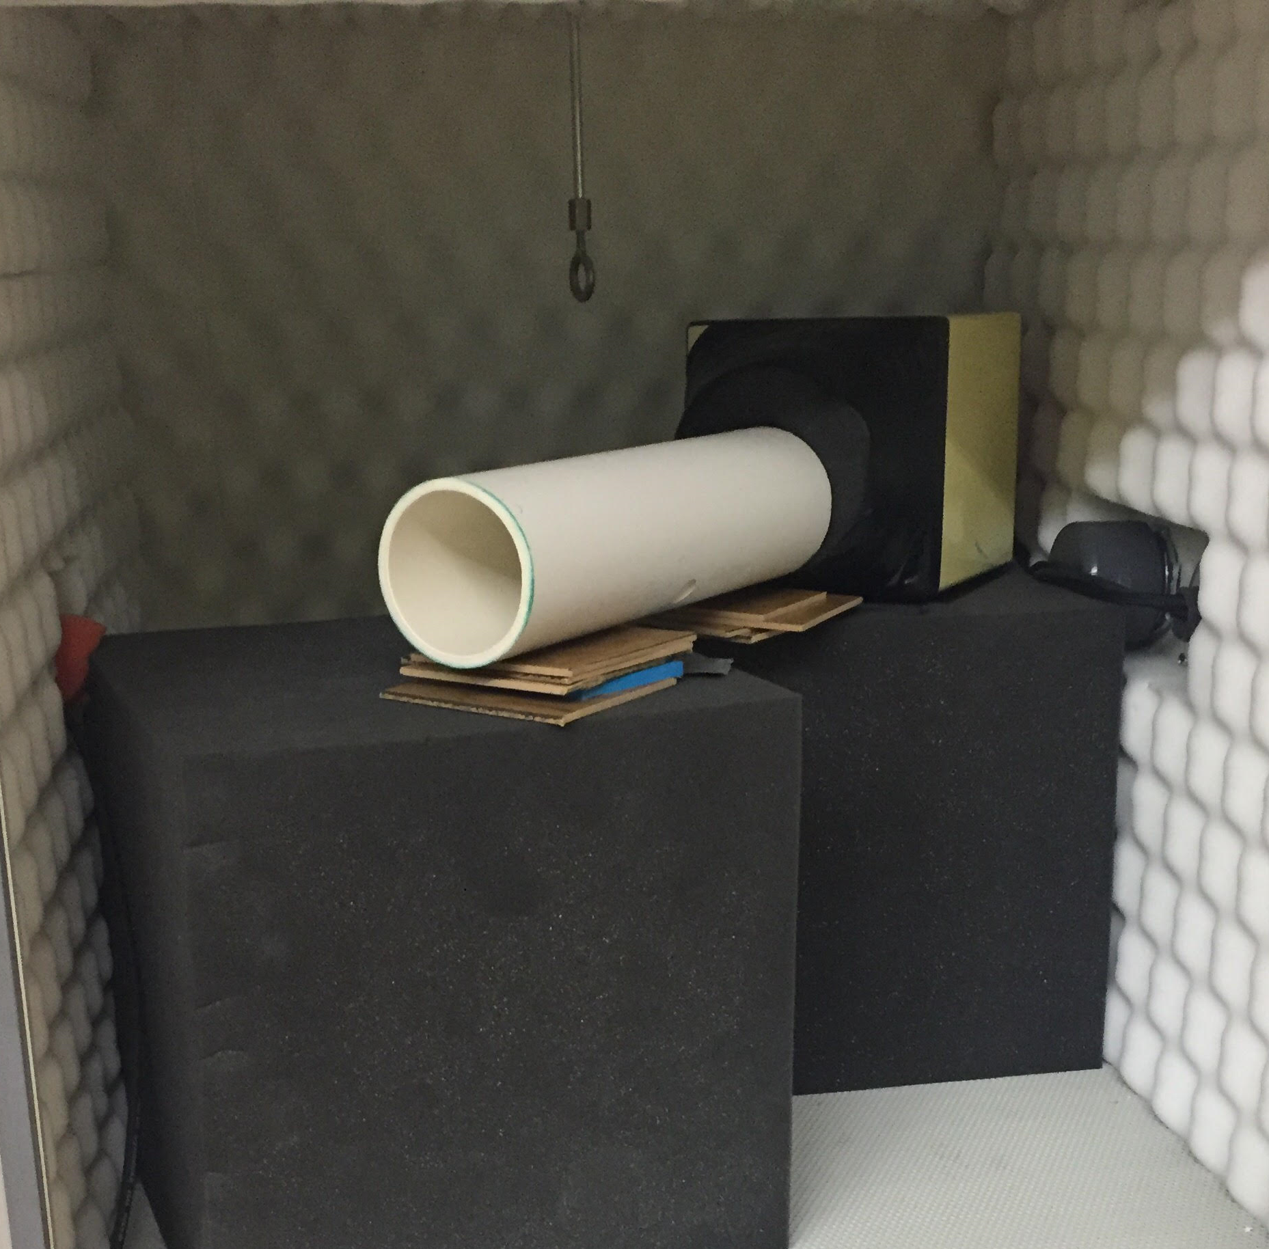
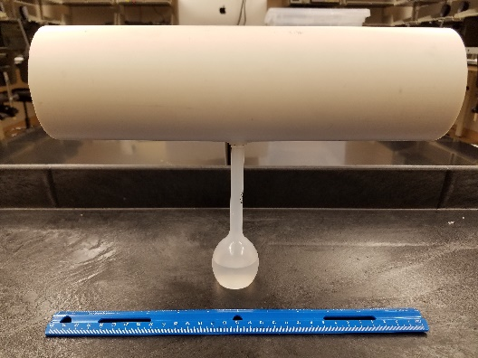
Experimental Lab Setup
(Single Resonator)

Slide 9
Single Resonator Results
Using the chemical flask as the resonator
Changed the volume of the Resonator’s cavity by adding water
% of Cavity filled w/ Water | Calculated Resonance Frequency | Measured Resonance Frequency | Percent Error
0 % | 175 Hz | 187 Hz | 6.85 %
20 % | 196 Hz | 206 Hz | 5.10 %
40 % | 226 Hz | 234 Hz | 3.54 %
50 % | 248 Hz | 254 Hz | 2.42 %
60 % | 277 Hz | 282 Hz | 1.81 %
80 % | 392 Hz | 387 Hz | -1.28 %
100 % | N/A (INF) | 459 Hz | N/A
Theoretical Resonance Frequency curve based on Cavity volume

Slide 10
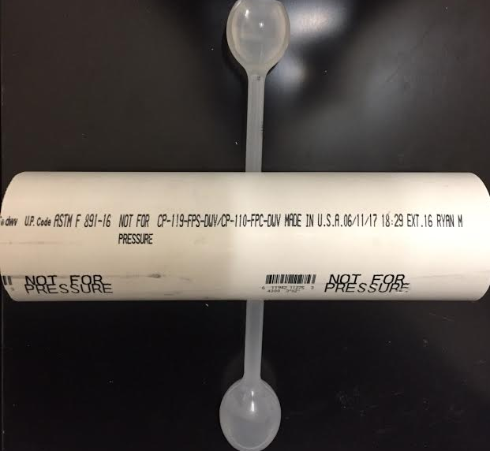
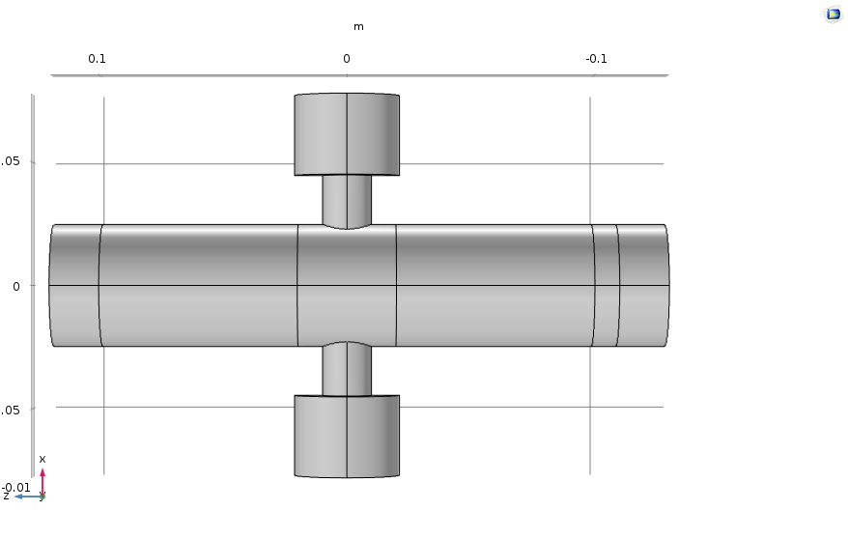
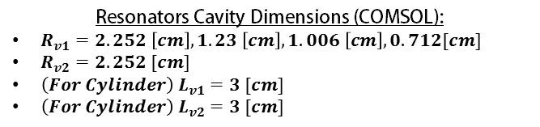
Experimental Lab Setup
(Coupled Resonators)
Physical Coupled Resonator Setup
Physical
Coupled Resonator Model
Comsol Coupled Resonator Model
Resonators Cavity Dimensions (COMSOL):
$R_{v1}=2.252 \left[cm\right], 1.23 \left[cm\right], 1.006 \left[cm\right], 0.712[cm]$
$R_{v2}=2.252 [cm]$
${\left(For Cylinder\right) L}_{v1}=3 [cm]$
${\left(For Cylinder\right) L}_{v2}=3 [cm]$

Slide 11
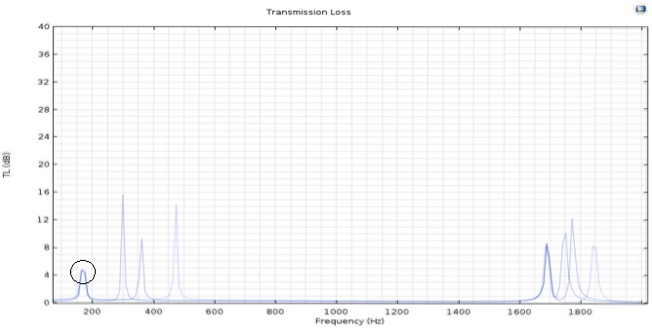
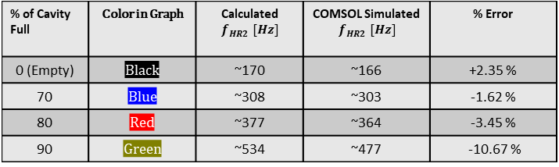
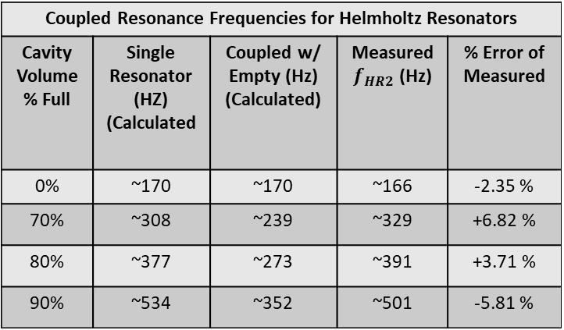
Coupled Resonator Results
Coupled Resonance Frequencies for Helmholtz Resonators
Cavity Volume % Full | Single Resonator (HZ) (Calculated | Coupled w/ Empty (Hz) (Calculated) | Measured $f_{HR2}$ (Hz) | % Error of Measured
0% | ~170 | ~170 | ~166 | -2.35 %
70% | ~308 | ~239 | ~329 | +6.82 %
80% | ~377 | ~273 | ~391 | +3.71 %
90% | ~534 | ~352 | ~501 | -5.81 %
% of Cavity Full | Color in Graph | Calculated $f_{HR2} [Hz]$ | COMSOL Simulated $f_{HR2} [Hz]$ | % Error
0 (Empty) | Black | ~170 | ~166 | +2.35 %
70 | Blue | ~308 | ~303 | -1.62 %
80 | Red | ~377 | ~364 | -3.45 %
90 | Green | ~534 | ~477 | -10.67 %
Notes:
Critical Coupling Condition -

Slide 12
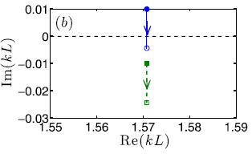
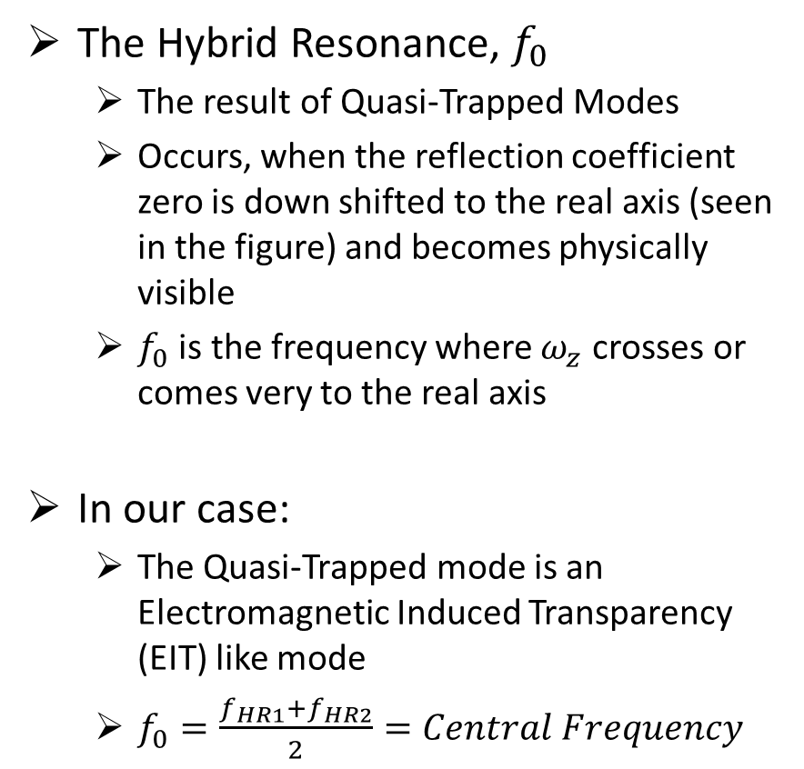
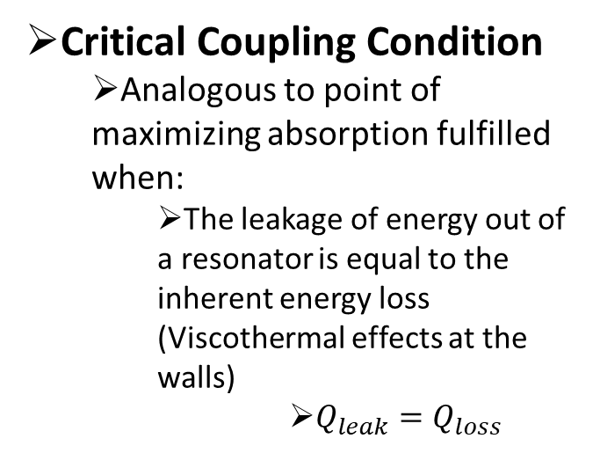
Coupled Resonators: Hybrid Resonance
The Hybrid Resonance, $f_{0}$
The result of Quasi-Trapped Modes
Occurs, when the reflection coefficient zero is down shifted to the real axis (seen in the figure) and becomes physically visible
$f_{0}$ is the frequency where $ω_{z}$ crosses or comes very to the real axis
In our case:
The Quasi-Trapped mode is an Electromagnetic Induced Transparency (EIT) like mode
$f_{0}=\frac{f_{HR1}+f_{HR2}}{2}=Central Frequency$
Critical Coupling Condition
Analogous to point of maximizing absorption fulfilled when:
The leakage of energy out of a resonator is equal to the inherent energy loss (Viscothermal effects at the walls)
$Q_{leak}=Q_{loss}$

Slide 13
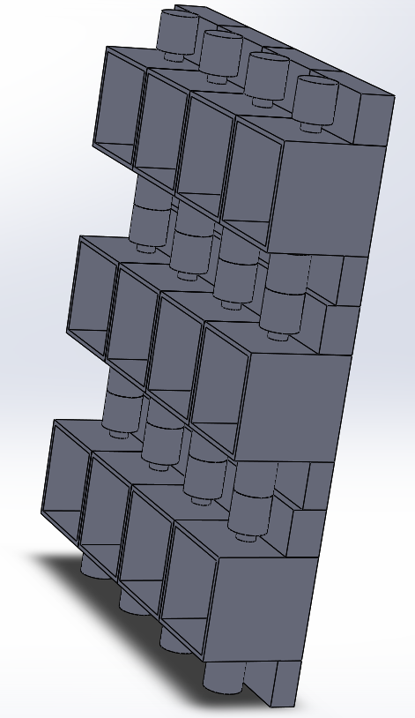
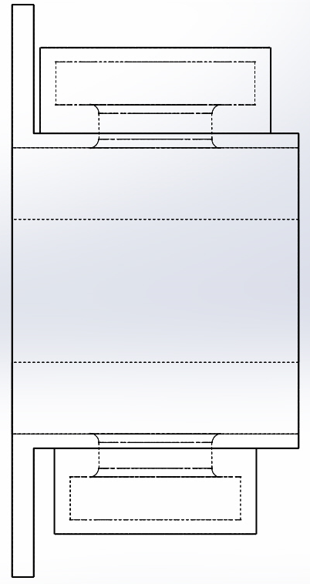
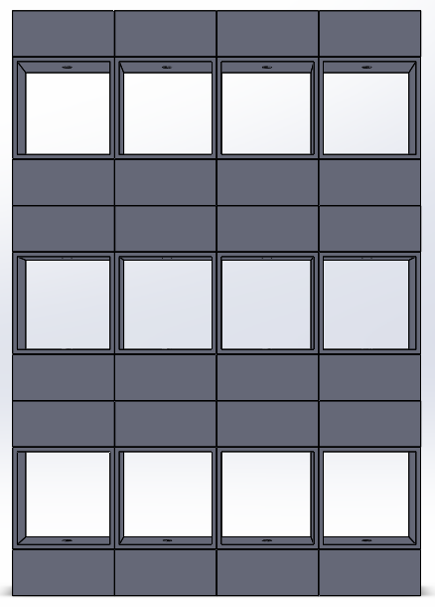
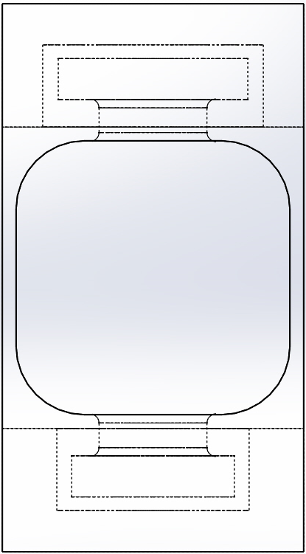
Example of Acoustic Metamaterial Design: miniature 3D-printed H.R. Arrays
Side View of Cell
Resonators
Front View of Cell
We have so far built several of these with varying levels of complexity.
Air Flow Channel (Waveguide)

Slide 14
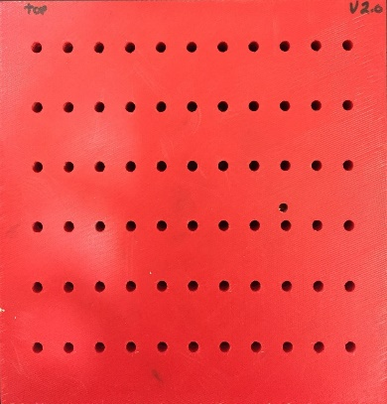
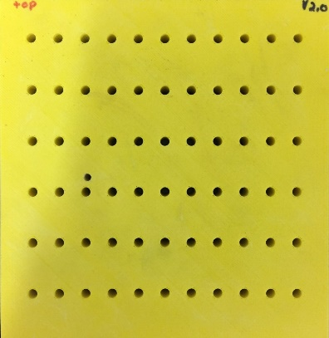
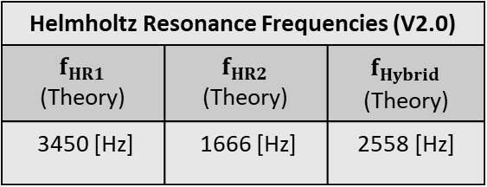
Acoustic Metamaterial
(v2.0) Results
Grid V2
Ref. Grid V2
Helmholtz Resonance Frequencies (V2.0)
$f_{HR1}$ (Theory) | $f_{HR2}$ (Theory) | $f_{Hybrid}$ (Theory)
3450 [Hz] | 1666 [Hz] | 2558 [Hz]
Results are currently under interpretation. Need impedance tube for better testing.

Slide 15
Outcomes & Deliverables
2017-2018
Characterized noise spectrum of benchmark cooling fan
Acquired lDS-Lindgren “quiet box” (University) and Agilent U8903B audio analyzer (CfM grant).
Acquired and developed Comsol Multiphysics acoustic simulation capabilities.
Developed simulation + theory + experiment for large single and coupled Helmholtz resonators (H.R.)
Designed (Solid-Works), fabricated (3D-printing) , and tested several prototype miniature coupled H.R. arrays.
Most recently, we pooled residual CfM funding with University year-end funding to acquire 4 mic impedance tube measurement system for 2018-19.

Slide 16
Technology Transfer To the
Companies
We had teleconferences with Harris:
August 2017: Discussed project details and requirements
September 2017: Discussed Fan Noise Frequencies and Basic Theory of Resonator Filter
November 2017: Discussed Acoustic Metamaterial Design using Helmholtz Resonators and Simulation Results
March 2018: Discussed the experimental results of the Fabricated Acoustic Metamaterial (V1.1) and other experimental results

Slide 17
Schedule
Summer 2018: Receive and commission BSWA 4 microphone impedance tube measurement system.
Summer and fall 2018: Design, simulate, and test further iterations of miniature coupled H.R. flow cells.
Fall 2018: Optimize flow cells for fan noise (and other applications?)
Fall 2018 and Spring 2019: File patent applications.
Spring 2019: Publish results (after patent applications are filed).
Impact
Next: After novel 3D-printed coupled H.R. arrays are successfully demonstrated, file appropriate patent applications.
Caveat: H.R. themselves are not patentable. However, application-specific coupled arrays of miniature H.R. flow cells may be patentable.
After patent applications are filed, publish results
Students
Ryan Hill, MSEE Spring 2019
Matias Mendieta and Patrick Bruce, BSEE Spring 2019

Slide 18
2017-2018 Budget
Direct Cost |  | Actual expenses
Student Salary & Benefits |  | 14,586
Tuition |  | 7,098
Supplies & Materials |  | 789
Travel |  | 1,285
Software* |  | 1,807
Equipment# |  | 10,799
Subtotal |  | 36,364
Indirect Cost
Overhead 10% |  | 3,636
Total |  | 40,000
Budget justification:
* Comsol Multiphysics acoustics module
# Agilent audio analyzer, and BSWA impedance tube system
Notes:
This is an example budget

Slide 19
Proposed 2018-19 Budget
Direct Cost |  | Requested Support
Student Salary & Benefits |  | 20,000
Tuition |  | 8,000
Supplies & Materials |  | 1,874
Software* |  | 1,990
Travel |  | 2,500
Equipment |  | 1,000
Publication |  | 1,000
Subtotal |  | 36,364
Indirect Cost
Overhead 10% |  | 3,636
Total |  | 40,000
Budget Justification: * Comsol “Live Link” for Solid Works
Notes:
This is an example budget

Slide 20
Conclusions
Single and multiple Helmholtz resonators (H.R.) can be accurately simulated using Comsol Multiphysics and employed for noise reduction at specific frequencies
Miniature arrays of H.R. flow cells can be:
designed using SolidWorks
fabricated using 3D-printing
simulated using Comsol
However, the current measurement system is inadequate to the task of full characterization due to uncontrolled environmental reflections of acoustic waves
Newly acquired 4 microphone impedance tube system will allow further development in 2018-19

Slide 21


Acknowledgements
This work was supported by the NSF Industry/University Cooperative Research Center for Metamaterials.
http://www.centerformetamaterials.org/
http://www.nsf.gov/
Notes:
Can insert additional logos and acknowledgements

Slide 22
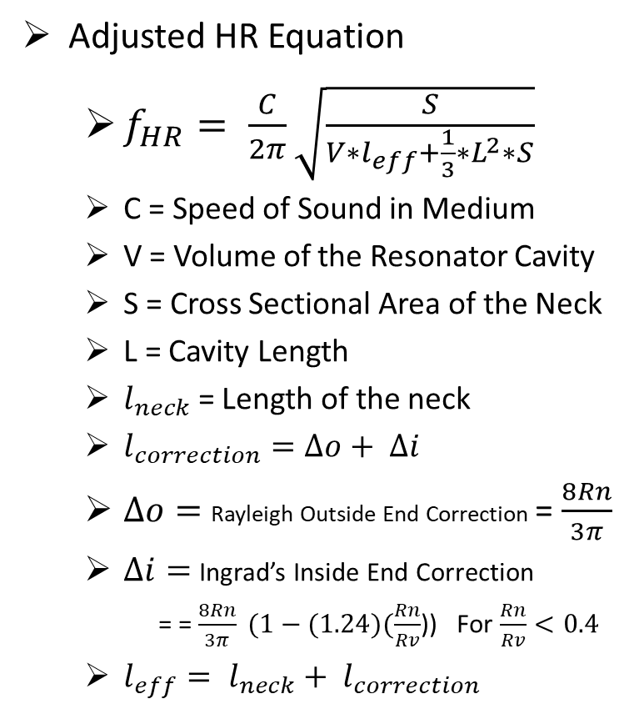
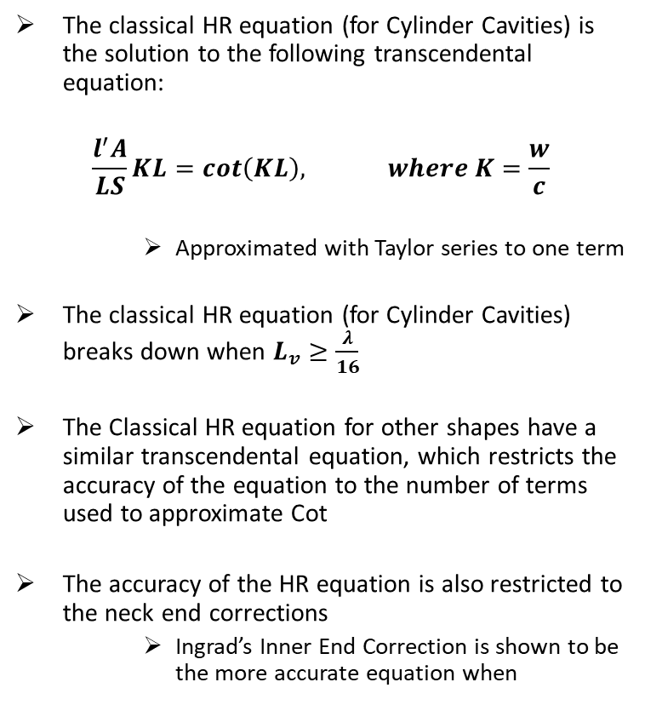
Helmholtz Equation Adjusted
The classical HR equation (for Cylinder Cavities) is the solution to the following transcendental equation:
$$\frac{l^{′}A}{LS}KL=cot\left(KL\right), where K=\frac{w}{c}$$
Approximated with Taylor series to one term
The classical HR equation (for Cylinder Cavities) breaks down when $L_{v}≥\frac{λ}{16}$
The Classical HR equation for other shapes have a similar transcendental equation, which restricts the accuracy of the equation to the number of terms used to approximate Cot
The accuracy of the HR equation is also restricted to the neck end corrections
Ingrad’s Inner End Correction is shown to be the more accurate equation when
Adjusted HR Equation
$f_{HR}= \frac{C}{2π}\sqrt{\frac{S}{V∗l_{eff}+\frac{1}{3}{∗L}^{2}∗S}}$
C = Speed of Sound in Medium
V = Volume of the Resonator Cavity
S = Cross Sectional Area of the Neck
L = Cavity Length
$l_{neck}$ = Length of the neck
$l_{correction}=∆o+ ∆i$
$∆o=$ Rayleigh Outside End Correction = $\frac{8Rn}{3π}$
$∆i=$ Ingrad’s Inside End Correction
= = $\frac{8Rn}{3π} (1−(1.24)(\frac{Rn}{Rv}$)) For $\frac{Rn}{Rv}<0.4$
$l_{eff}= l_{neck}+ l_{correction}$

Slide 23
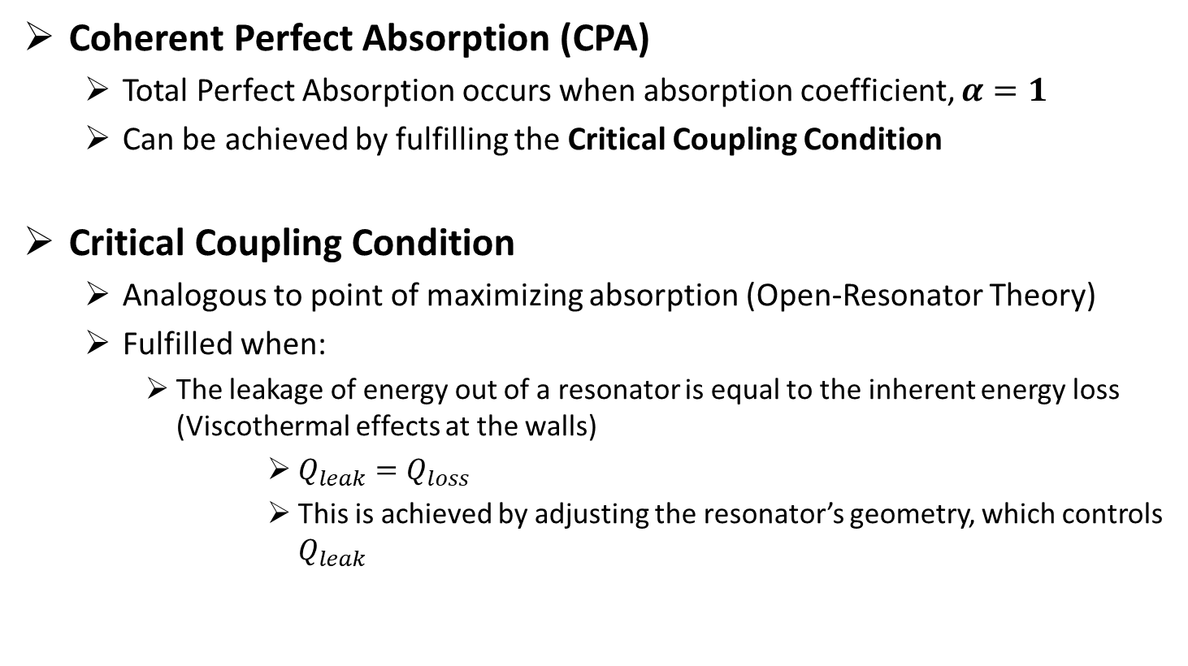
Coherent Perfect Absorption
And
Critical Coupling Condition
Coherent Perfect Absorption (CPA)
Total Perfect Absorption occurs when absorption coefficient, $α=1$
Can be achieved by fulfilling the Critical Coupling Condition
Critical Coupling Condition
Analogous to point of maximizing absorption (Open-Resonator Theory)
Fulfilled when:
The leakage of energy out of a resonator is equal to the inherent energy loss (Viscothermal effects at the walls)
$Q_{leak}=Q_{loss}$
This is achieved by adjusting the resonator’s geometry, which controls $Q_{leak}$
Notes:
Critical Coupling Condition -

Slide 24
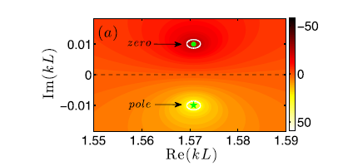
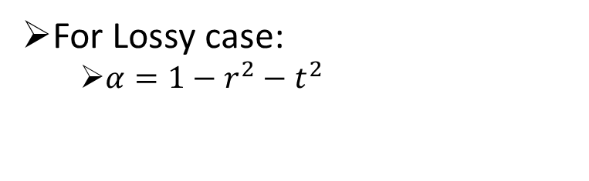
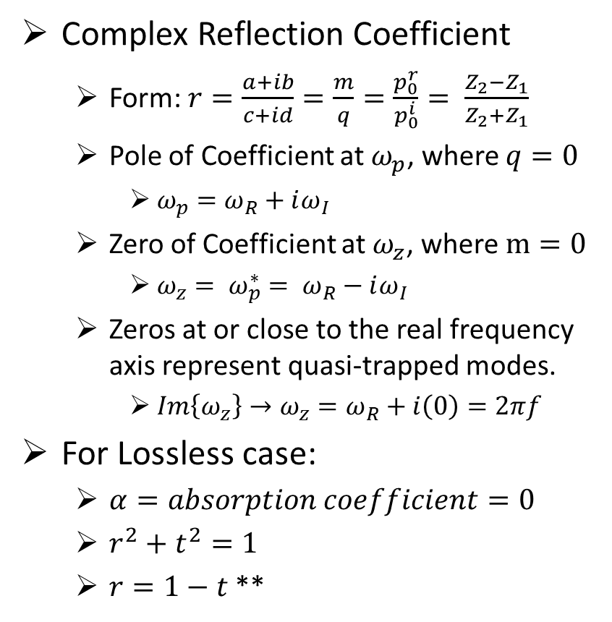
Complex Frequency Plane
And
Reflection Coefficient
Complex Reflection Coefficient
Form: $r=\frac{a+ib}{c+id}=\frac{m}{q}=\frac{p_{0}^{r}}{p_{0}^{i}}= \frac{Z_{2}−Z_{1}}{Z_{2}+Z_{1}}$
Pole of Coefficient at $ω_{p}$, where $q=0$
$ω_{p}=ω_{R}+iω_{I}$
Zero of Coefficient at $ω_{z}$, where $m=0$
$ω_{z}= ω_{p}^{∗}= ω_{R}−iω_{I}$
Zeros at or close to the real frequency axis represent quasi-trapped modes.
$Im\left\{ω_{z}\right\}→ω_{z}=ω_{R}+i\left(0\right)=2πf$
For Lossless case:
$α=absorption coefficient=0$
$r^{2}+t^{2}=1$
$r=1−t$ **
Fig. Example of Reflection Coefficient plotted on Complex Frequency Plane
(lossless case)
For Lossy case:
$α=1−r^{2}−t^{2}$

Slide 25
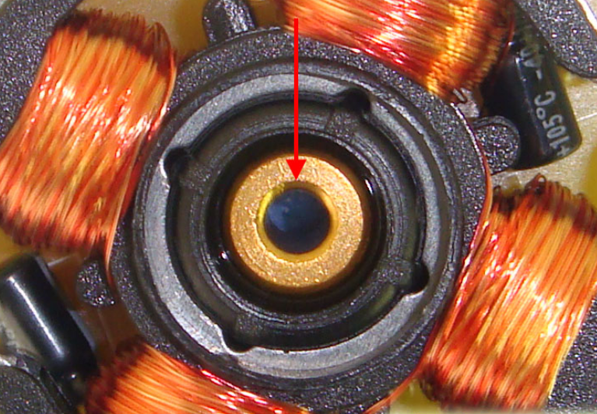
Sources of Fan Resonance
Sources of Fan Resonance
1.) Fan Rotation Frequency (SBRF)
Fan RPM / 60 (s/min) = 7000 RPM / 60 (s/min) = 117 Hz
2.) Blade Pass Frequency (BPF)
BPF = [( (No. of Blades) * Fan RPM) 60 (s/min)] = 817 Hz
Sleeve Bearing
BPF Harmonics | 817 Hz | 1634 Hz | 2451 Hz | 3268 Hz

Slide 26
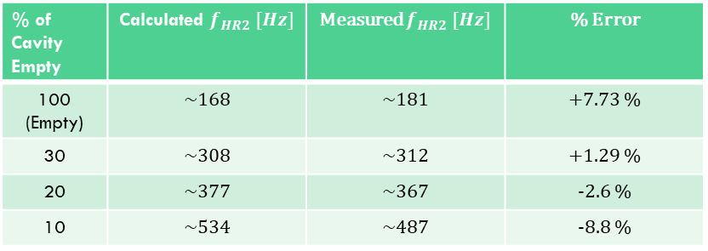
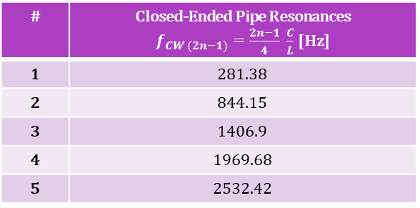
Coupled Resonator Results (Hard B.C.)
% of Cavity Empty | Calculated $f_{HR2} [Hz]$ | Measured $f_{HR2} [Hz]$ | % Error
100 (Empty) | ~168 | ~181 | +7.73 %
30 | ~308 | ~312 | +1.29 %
20 | ~377 | ~367 | -2.6 %
10 | ~534 | ~487 | -8.8 %
# | Closed-Ended Pipe Resonances $f_{CW (2n−1)}=\frac{2n−1}{4} \frac{C}{L}$ [Hz]
1 | 281.38
2 | 844.15
3 | 1406.9
4 | 1969.68
5 | 2532.42

Slide 27
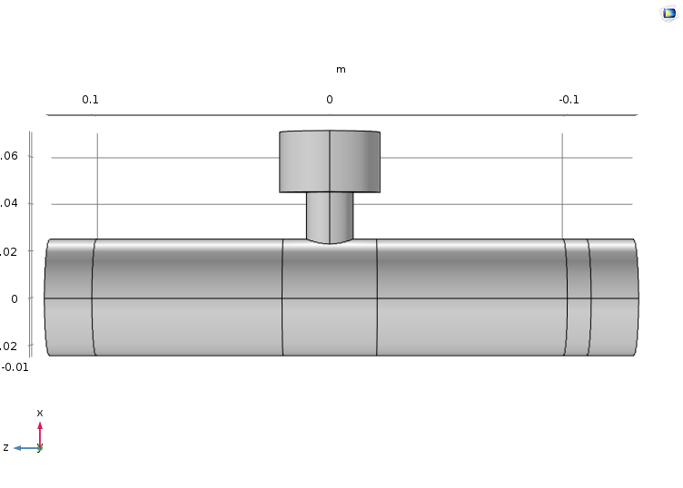

$$Single Resonator Setup and Purpose$$
Resonator Dimensions
$R_{v1}=2.15 cm$
$L_{v1}=3.27 cm$
$R_{n}=1 cm$
$L_{corr}=1.08 cm$
$L_{n1}=2 cm, 4 cm, 6 cm, 8 cm$
Waveguide Dimensions
$L_{w}=20 cm$
$R_{w}=2 cm$
Varying $L_{n1}$, while keeping all other dimensions the same.

Slide 28
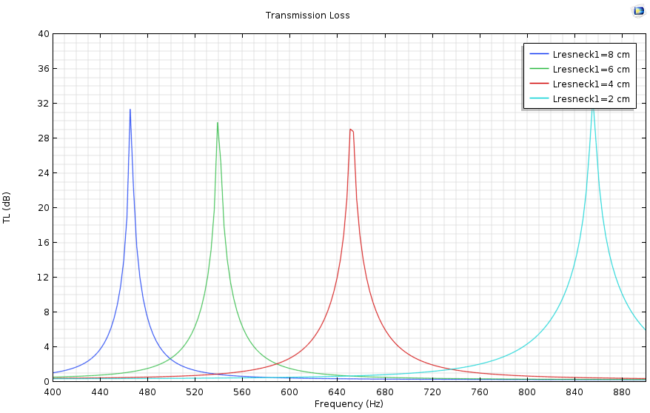
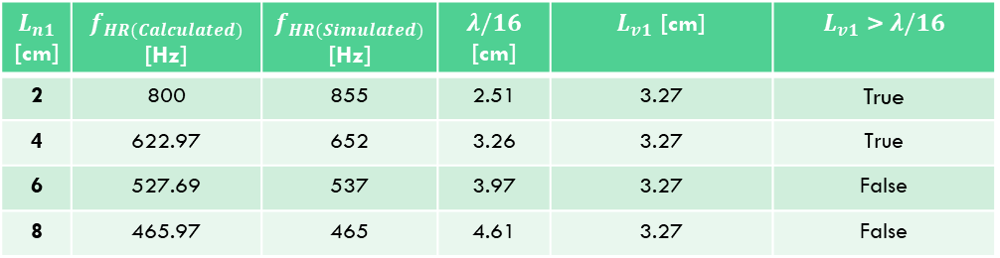
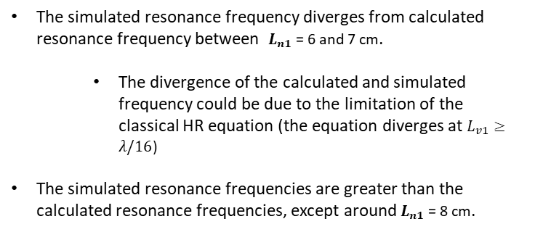
$$Single Resonator Simulation Results$$
$L_{n1}$ [cm] | $f_{HR(Calculated)}$ [Hz] | $f_{HR(Simulated)}$ [Hz] | $λ/16$ [cm] | $L_{v1}$ [cm] | $L_{v1}$ > $λ/16$
2 | 800 | 855 | 2.51 | 3.27 | True
4 | 622.97 | 652 | 3.26 | 3.27 | True
6 | 527.69 | 537 | 3.97 | 3.27 | False
8 | 465.97 | 465 | 4.61 | 3.27 | False
Simulation Results
The simulated resonance frequency diverges from calculated resonance frequency between $L_{n1}$ = 6 and 7 cm.
The divergence of the calculated and simulated frequency could be due to the limitation of the classical HR equation (the equation diverges at $L_{v1}≥λ/16$)
The simulated resonance frequencies are greater than the calculated resonance frequencies, except around $L_{n1}$ = 8 cm.

Slide 29








Coupled Resonators Simulation Setup
For $f_{HR1}$= $f_{HR2}$
For $f_{HR1}$!= $f_{HR2}$
Resonator #1 Dimensions
$R_{v1}=2.15 cm$
$L_{v1}=3.27 cm$
$R_{n1}=1 cm$
$L_{corr}=1.08 cm$
$L_{n1}=2 cm, 4 cm,$
$$6 cm, 8 cm$$
Resonator #1 Dimensions
$R_{v1}=2.15 cm$
$L_{v1}=3.27 cm$
$R_{n1}=1 cm$
$L_{corr}=1.08 cm$
$L_{n1}=2 cm, 4 cm,$
$$6 cm, 8 cm$$
Resonator #2 Dimensions
$R_{v2}=2.15 cm$
$L_{v2}=3.27 cm$
$R_{n2}=1 cm$
$L_{corr}=1.08 cm$
$L_{n2}=2 cm, 4 cm,$
$$6 cm, 8 cm$$
Resonator #2 Dimensions
$R_{v2}=2.15 cm$
$L_{v2}=2.58 cm$
$R_{n2}=1 cm$
$L_{corr}=1.08 cm$
$L_{n2}=2 cm, 4 cm,$
$$6 cm, 8 cm$$
The coupled resonator simulation is run for two cases:
Where both resonators have the same resonance frequency
Where the resonators have different resonance frequencies
For each case, the neck length of both resonators are varied.
Waveguide Dimensions
$L_{w}=20 cm$
$R_{w}=2 cm$
Waveguide Dimensions
$L_{w}=20 cm$
$R_{w}=2 cm$

Slide 30
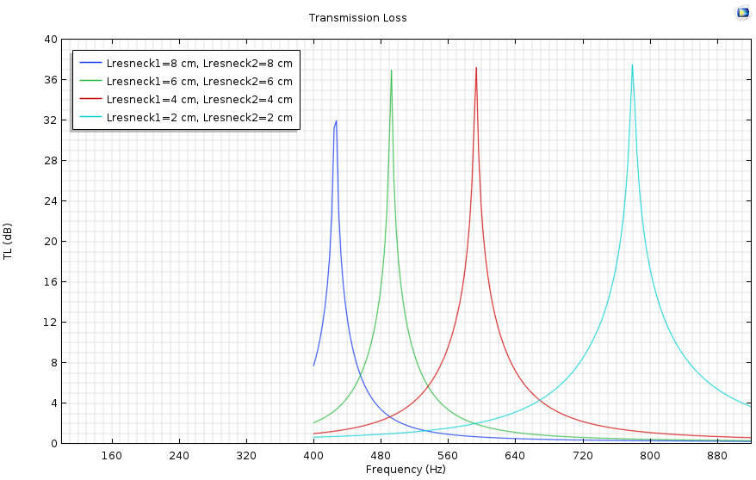
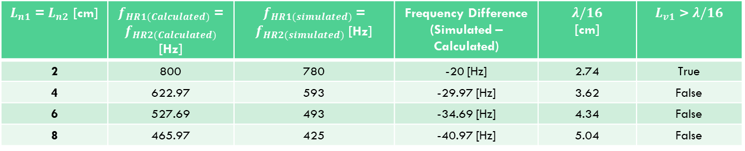
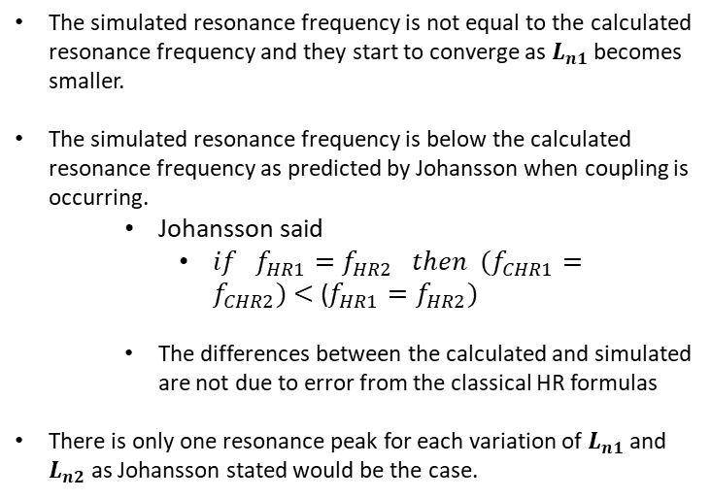
Coupled Resonators $f_{HR1}$= $f_{HR2}$
$L_{n1}$ = $L_{n2}$ [cm] | $f_{HR1(Calculated)}$ = $f_{HR2(Calculated)}$ [Hz] | $f_{HR1(simulated)}$ = $f_{HR2(simulated)}$ [Hz] | Frequency Difference (Simulated – Calculated) | $λ/16$ [cm] | $L_{v1}$ > $λ/16$
2 | 800 | 780 | -20 [Hz] | 2.74 | True
4 | 622.97 | 593 | -29.97 [Hz] | 3.62 | False
6 | 527.69 | 493 | -34.69 [Hz] | 4.34 | False
8 | 465.97 | 425 | -40.97 [Hz] | 5.04 | False
Simulation Results
The simulated resonance frequency is not equal to the calculated resonance frequency and they start to converge as $L_{n1}$ becomes smaller.
The simulated resonance frequency is below the calculated resonance frequency as predicted by Johansson when coupling is occurring.
Johansson said
$if f_{HR1}=f_{HR2} then (f_{CHR1}=f_{CHR2}) \text{<}\text{ (}f_{HR1}=f_{HR2})$
The differences between the calculated and simulated are not due to error from the classical HR formulas
There is only one resonance peak for each variation of $L_{n1}$ and $L_{n2}$ as Johansson stated would be the case.

Slide 31
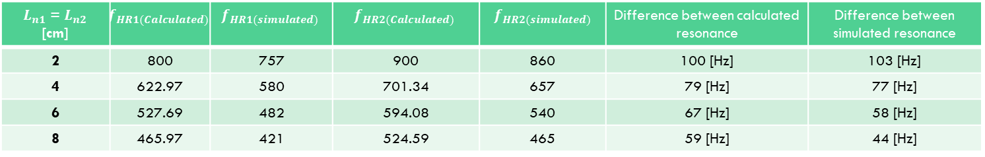

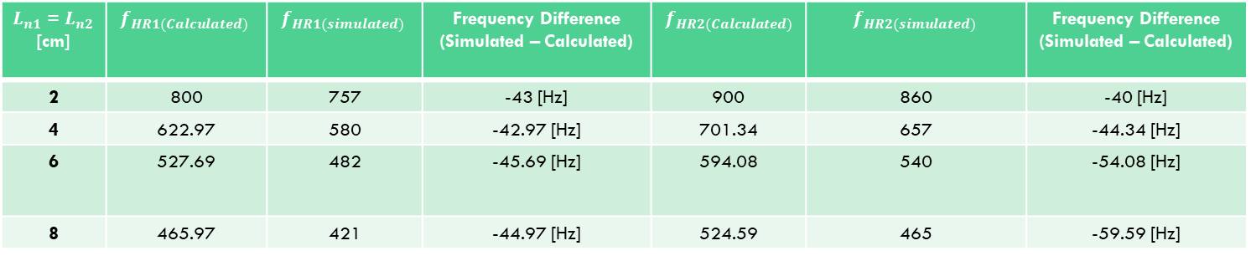
Coupled Resonators $f_{HR1}$!= $f_{HR2}$
$L_{n1}$ = $L_{n2}$ [cm] | $$f_{HR1(Calculated)}$$ | $$f_{HR1(simulated)}$$ | $$f_{HR2(Calculated)}$$ | $$f_{HR2(simulated)}$$ | Difference between calculated resonance | Difference between simulated resonance
2 | 800 | 757 | 900 | 860 | 100 [Hz] | 103 [Hz]
4 | 622.97 | 580 | 701.34 | 657 | 79 [Hz] | 77 [Hz]
6 | 527.69 | 482 | 594.08 | 540 | 67 [Hz] | 58 [Hz]
8 | 465.97 | 421 | 524.59 | 465 | 59 [Hz] | 44 [Hz]
$L_{n1}$ = $L_{n2}$ [cm] | $$f_{HR1(Calculated)}$$ | $$f_{HR1(simulated)}$$ | Frequency Difference (Simulated – Calculated) | $$f_{HR2(Calculated)}$$ | $$f_{HR2(simulated)}$$ | Frequency Difference (Simulated – Calculated)
2 | 800 | 757 | -43 [Hz] | 900 | 860 | -40 [Hz]
4 | 622.97 | 580 | -42.97 [Hz] | 701.34 | 657 | -44.34 [Hz]
6 | 527.69 | 482 | -45.69 [Hz] | 594.08 | 540 | -54.08 [Hz]
8 | 465.97 | 421 | -44.97 [Hz] | 524.59 | 465 | -59.59 [Hz]
According to Johansson,
The coupled higher pitch is higher and the coupled lower pitch is lower than the uncoupled ones.
$f_{CHR2}$> $f_{HR2} and f_{CHR1}<f_{HR1}$
The difference between the coupled pitch and uncoupled pitch becomes larger as the difference between the uncoupled resonant frequencies decreases.
The coupled lower pitch is lower but the coupled higher pitch is Not higher.
As the difference between the uncoupled resonance becomes smaller, as seen in table 1, the larger the difference between the coupled and uncoupled pitches become, as seen in table 2.

Slide 32
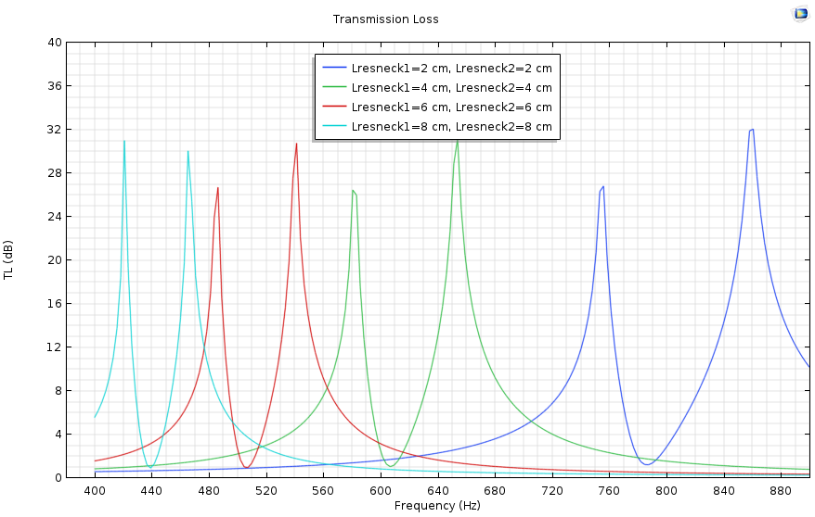
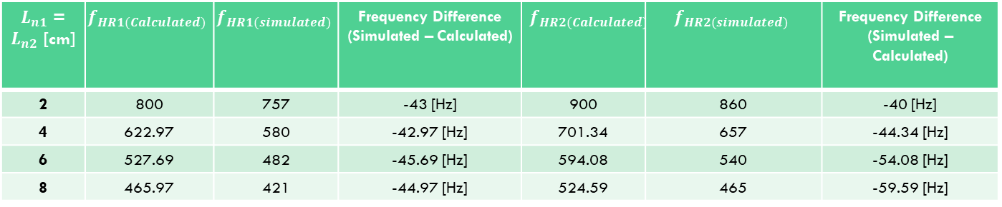
Coupled Resonators $f_{HR1}$!= $f_{HR2}$ (Continued)
$L_{n1}$ = $L_{n2}$ [cm] | $$f_{HR1(Calculated)}$$ | $$f_{HR1(simulated)}$$ | Frequency Difference (Simulated – Calculated) | $$f_{HR2(Calculated)}$$ | $$f_{HR2(simulated)}$$ | Frequency Difference (Simulated – Calculated)
2 | 800 | 757 | -43 [Hz] | 900 | 860 | -40 [Hz]
4 | 622.97 | 580 | -42.97 [Hz] | 701.34 | 657 | -44.34 [Hz]
6 | 527.69 | 482 | -45.69 [Hz] | 594.08 | 540 | -54.08 [Hz]
8 | 465.97 | 421 | -44.97 [Hz] | 524.59 | 465 | -59.59 [Hz]
Simulation Results
Some signs of coupling have been noted, in the previous slide.
There are no hybrid frequencies in the results, but this could be due to the Comsol model not taking into account the Thermoviscosity.
The simulation results shown to the left, look similar to a coupled EIT-like mode, similar to that seen on slide 6.

